Slide 1
VIRTUAL ASSISTANT

Slide 2
Agenda :
Abstract
Introduction
Objective
Existing System
Proposed System
Software And Hardware Requirements
System Modules
Output Screen
Conclusion

Slide 3
Abstract
This project aims to develop a Virtual-Assistant.
Jarvis (JUST ANOTHER RATHER VIRTUAL INTELLIGENT SYSTEM), draws its inspiration from virtual assistants like Cortana for Windows, and Siri for iOS, Alexa by amazon.
It has been designed to provide a user-friendly interface for carrying out a variety of tasks by employing certain well-defined commands.
Users can interact with the assistant through voice commands input.
As a personal assistant, Jarvis assists the end-user with day-to-day activities like general human conversation, searching queries in google, Bing or yahoo, searching for videos, retrieving images, live weather conditions, word meanings, searching for medicine details, playing music, etc.…
The users statements/commands are analysed with the help of machine learning to give an optimal solution using Python language.
Keywords:- Personal Assistant, Automation, Machine Learning

Slide 4
INTRODUCTION TO VIRTUAL ASSISTANT:
Gone are the days when humans depended on other humans for help or services.
The digitalization of the world made sure that humans no need to contact
anyone else to seek help, they could depend on a far more efficient and reliable
device which can take care of their everyday needs.
The computers, mobiles, laptops, etc., became a part of us and our daily life, It
could carry out simple calculations to complex programs to reduce monotonous
work and waste of manpower.
Virtual Personal Assistant(VPA) has almost become a basic necessity in all
electronic devices so as to execute the required problems easily.
More than just being a bot , VPA can make life easier for the user in various ways.

Slide 5
INTRODUCTION TO VIRTUAL ASSISTANT:
Artificial Intelligence’s main goal is to make Human interaction with
computers and other electronic devices much easier and practical .
Nowadays Virtual Personal Assistants(VPA) who can carry out tasks
required for daily needs with just a “meaningful phrase” is a fast
growing area . Many companies have used the dialogue systems technology
to establish various kinds of Virtual Personal Assistants(VPAs) based on their
applications and areas, such as Microsoft’s Cortana, Apple’s Siri, Amazon
Alexa, Google Assistant. However in this proposal , we have used a different
approach to bring down the error percentage of the personal assistant. It
incorporates both the visual and audio information to deduce what the
person says.

Slide 6
OBJECTIVE
Main objective of building personal assistant software (a virtual assistant) is using semantic data sources available on the web, user generated content and providing knowledge from knowledge databases. The main purpose of an intelligent virtual assistant is to answer questions that users may have, The intelligent virtual assistant is available as a call-button operated service where a voice asks the user “What can I do for you?” and then responds to verbal input.
Virtual assistants can tremendously save you time. We spend hours in online research and then making the report in our terms of understanding. JARVIS can do that for you. Provide a topic for research and continue with your tasks while JARVIS does the research. Another difficult task is to remember test dates, birthdates or anniversaries. It comes with a surprise when you enter the class and realize it is class test today. Just tell JARVIS in advance about your tests and he reminds you well in advance so you can prepare for the test.

Slide 7
EXISTING SYSTEM
There already exist a number of desktop virtual assistants. A few examples of current virtual assistants available in market are discussed in this section along with the tasks they can provide and their drawbacks. Personal assistant software that interfaces with the user through voice interface, recognizes commands and acts on them. It learns to adapt to user’s speech and thus improves voice recognition over time. It also tries to converse with the user when it does not identify the user request.

Slide 8
PROPOSED SYSTEM
The major milestone in this project is to achieve increased accuracy
of the speech to text software.
Whenever the virtual assistant is activated, An Interface appears which shows the componential
features of the system like (battery power, System volume, Used Ram, etc…)
Can perform Complex -to- Complex mathematical operations at your command.
The virtual assistant allows user to perform tasks without manual interaction by initiating
voice commands like :
Browsing your related web searches.
Playing audio, video on command.
Locating your desired places on maps.
Opens installed system applications on command.
Opens or Closes tabs and windows.
Can read the selected Text.
Can make a note of your daily plans.
Performs file operations such as Undo, Redo, Moving cursor to top/bottom…
Records your voice.
Takes Screenshots without manual interaction.

Slide 9
Packages/Module Used:
Speech recognition – Package used for speech recognition
pyttsx3
Numpy
Random
Tkinter
Time
Datetime
imageGrab
Pickle
Roman
Os
Requests
Pyautogui
Os.Path
Pil.Image
gTTs (get text to speech)
BytesIO
Clipboard
Build
Pywhatkit
Play sound
StringIO
Pyperclip
Googleapiclient
Youtube_dl
Webbrowser
Pyowm
Flask
Pytz
Client
Smtplib
Soundevice
Email.Message
Subprocess
pyaudio
Wikipedia
Write
Wolframalpha
Testcode
Os.startfile

Slide 10
Software And Hardware Requirements:
Hardware requirements:
Intel Core i3 processor or later.
RAM 2GB or more.
Microphone
Speakers
Software requirements:
Windows 10(64-bit) or above.
Python 3.7 or later
Chrome Driver
Stable Internet Connection

Slide 11
Output Screen:
The final output can be one of the various tasks that the personal assistant can execute. The input is basically converted into phrase which are connected to executable commands.
This is then processed using various algorithms to turn these inputs into a meaningful phrase that is present in the system.
This phrase is then cross checked for any commands or responses that might be connected to the phrase. Then the response(s) is either printed or the command is executed.

Slide 12
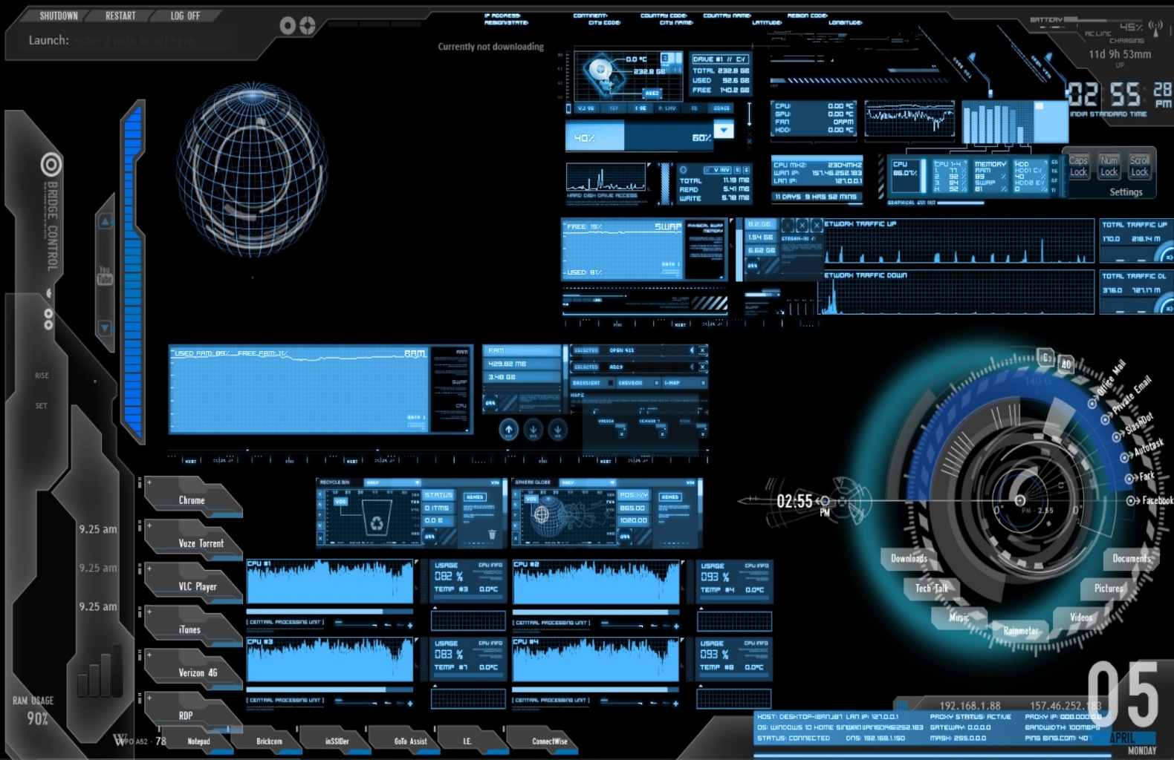
This picture shows the Graphical Module of the personal virtual assistant. This screen shows the status of the machine like(battery, volume, RAM capacity) and it also shows the Time, Date and other necessary applications.

Slide 13
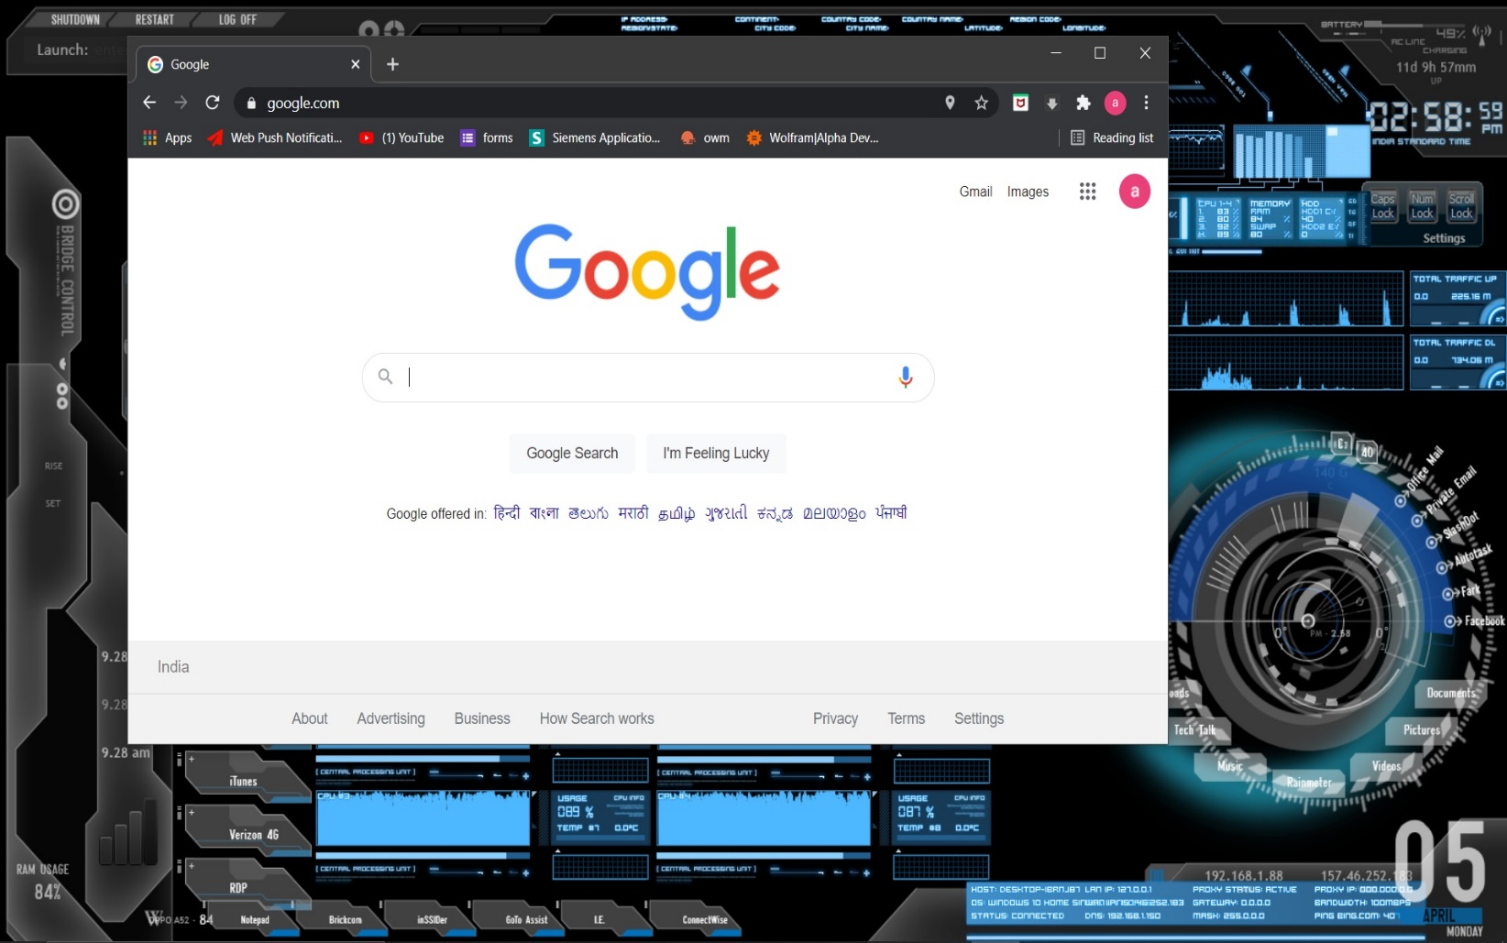
When a command is given to open google the virtual assistant opens the google.com website on your home/default browser as shown in the picture.

Slide 14
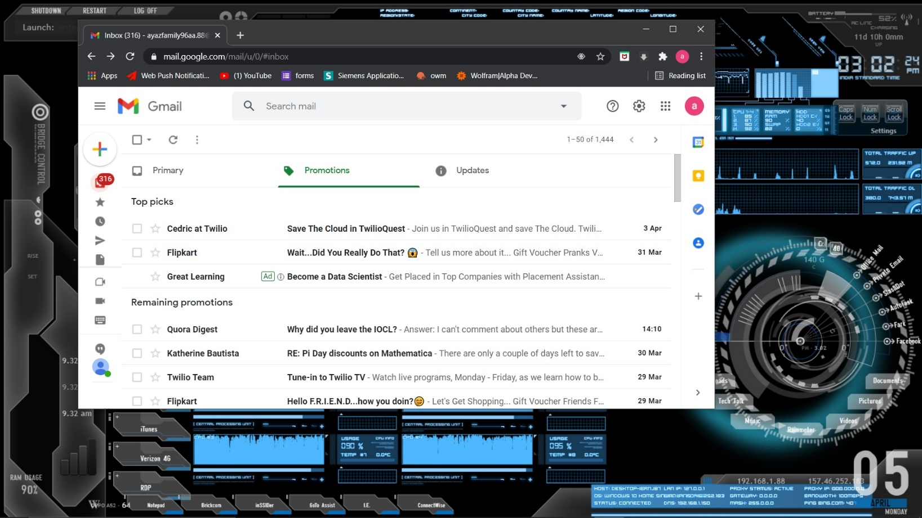
If the command is given is given to “open my inbox” or “open my mails” the virtual assistant opens your Gmail as shown in the picture below.

Slide 15
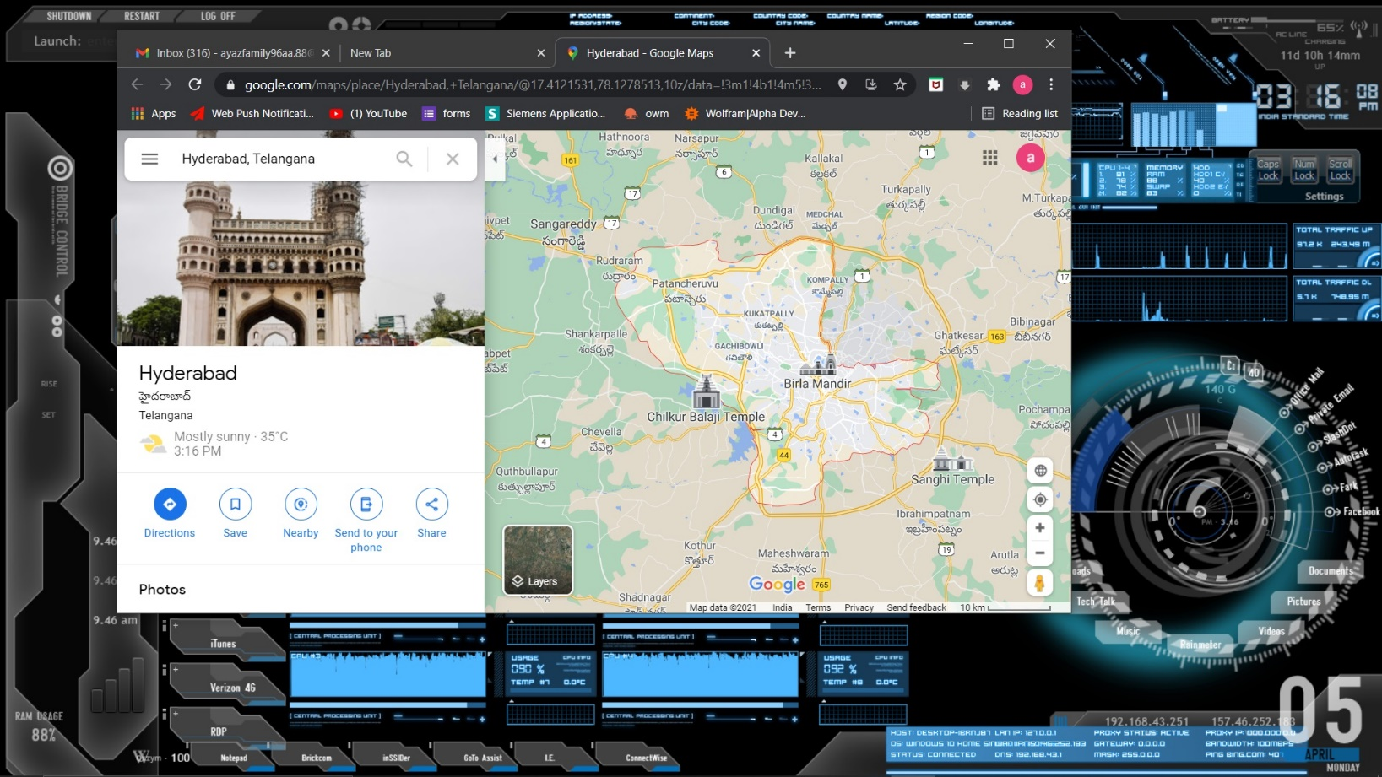
If the command is given “locate Hyderabad” or “where is Hyderabad” the virtual assistant then shows the location you asked for as shown in the picture below.

Slide 16
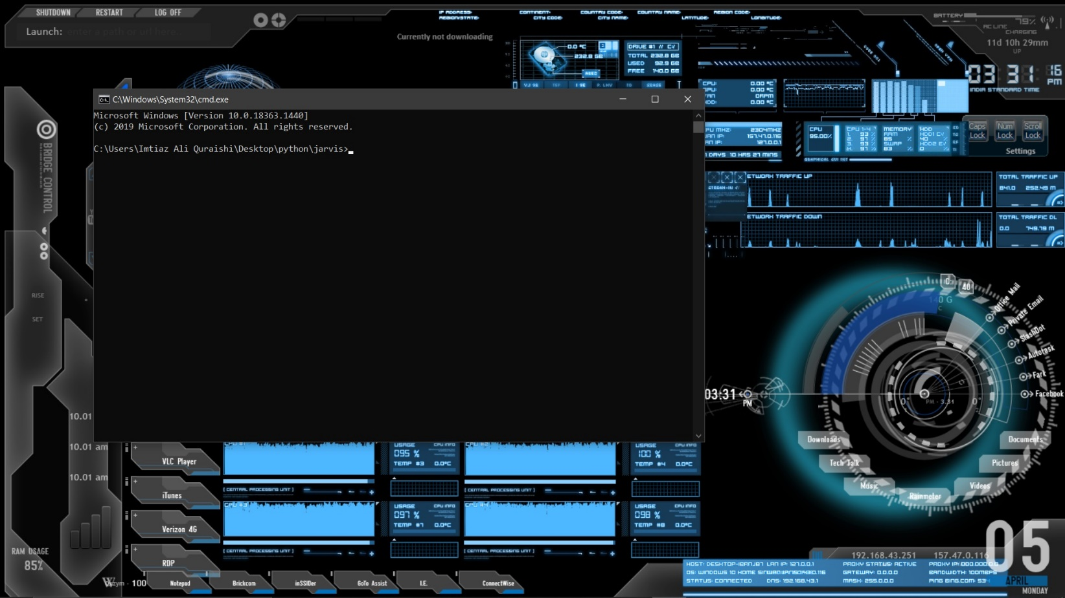
You can also open any application on your PC for example here we have opened our command prompt as shown in the picture below.

Slide 17
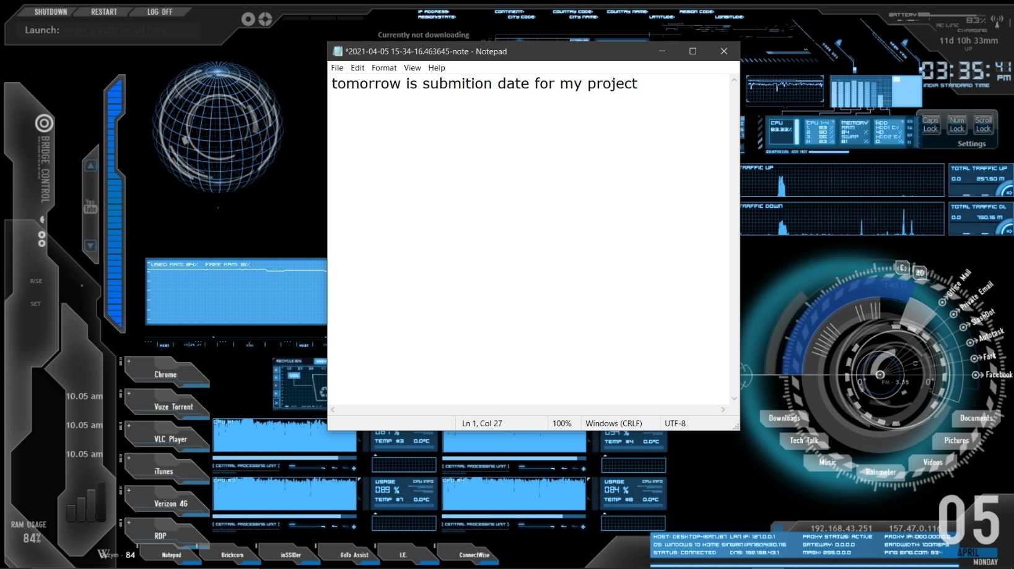
We can also command the virtual assistant to make a note for example your daily tasks or your grocery lists or anything you want as shown in the picture below.

Slide 18
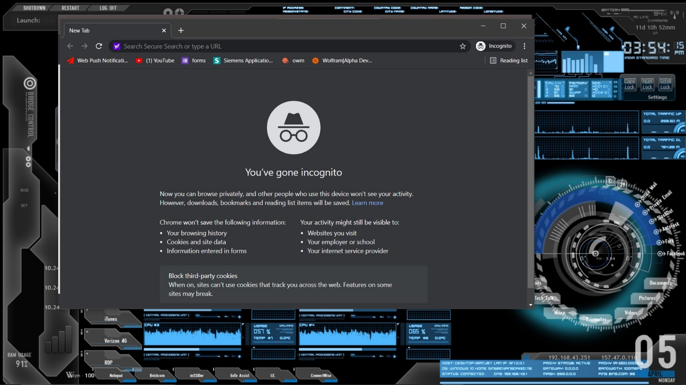
In this picture the user asks the virtual assistant to open a “New Incognito tab” likewise you can also ask the assistant to open a tab etc.…

Slide 19
Conclusion:
It is mainly built to make a much more efficient VPA that they can be brought into much more practical day-to-day uses. But the system has its own limitation. Though the efficiency is high the time consumption for each task to complete maybe higher than the other VPA’s and also the complexity of the algorithms and the concepts would make it very tough to tweak it if needed in the future.

Slide 20
THANK YOU

